Slide 1
Django Template
江琳

Slide 2
Static files

Slide 3
Static files
Aside from the HTML generated by the server, web applications generally need to serve additional files — such as images, JavaScript, or CSS — necessary to render the complete web page. In Django, we refer to these files as “static files”.

Slide 4

settings
Step1: create a folder called “static”
library
library
accounts
books
static
manage.py

Slide 5
settings
Step 2: open settings.py
STATIC_URL = '/static/’
STATICFILES_DIRS = (
os.path.join(BASE_DIR, "static"),
)

Slide 6
settings
Set up TEMPLATES
TEMPLATES = [ { 'BACKEND': 'django.template.backends.django.DjangoTemplates', 'DIRS': [os.path.join(BASE_DIR, 'templates')], 'APP_DIRS': True, 'OPTIONS': { 'context_processors': [ 'django.template.context_processors.debug', 'django.template.context_processors.request', 'django.contrib.auth.context_processors.auth', 'django.contrib.messages.context_processors.messages', 'django.template.context_processors.static', ], }, }, ]

Slide 7
example
For example we want to use Bootstrap as web framework.
Getting bootstrap: http://getbootstrap.com/docs/3.3/getting-started/
Store the boostrop we downlown into “static” folder we created

Slide 8
example
static
bootstrap
css
js

Slide 9
example
Open homepage.html
<head> <meta charset=“UTF-8”> <title>Library System</title>
<script src="{{ STATIC_URL }}bootstrap/js/jquery-3.2.1.min.js" type="text/javascript" charset="utf-8"></script> <script type="text/javascript" src="{{ STATIC_URL }}boostrap/js/boostrap.min.js">
</script> <link rel="stylesheet" type="text/css" href="{{ STATIC_URL }}boostrap/css/boostrap.min.css"> </head>

Slide 10
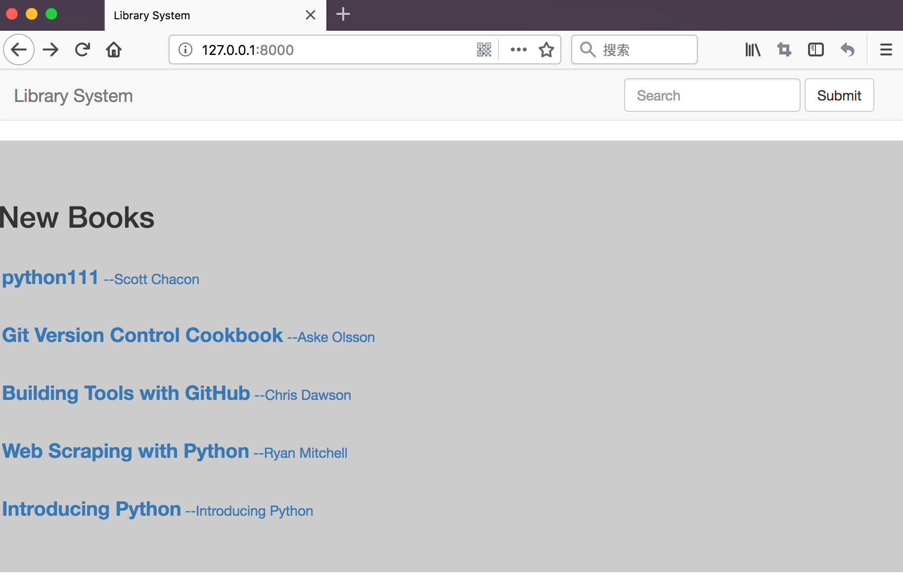
example
Let write a navbar using boostrap

Slide 11
<nav class="navbar navbar-default"> <div class="container-fluid"> <div class="navbar-header"> <button type="button" class="navbar-toggle collapsed" data-toggle="collapse" data-target="#bs-example-navbar-collapse-1" aria-expanded="false"> <span class="sr-only">Toggle navigation</span> <span class="icon-bar"></span> <span class="icon-bar"></span> <span class="icon-bar"></span> </button> <a class="navbar-brand" href="/">Library System</a> </div> <div class="collapse navbar-collapse" id="bs-example-navbar-collapse-1"> <form class="navbar-form navbar-right" method="get" action="{% url 'book_list' %}"> <div class="form-group"> <input type="text" class="form-control" placeholder="Search" name="keyword"> </div> <button type="submit" class="btn btn-default">Submit</button> </form> </div> </div> </nav>

Slide 12
Build-in template tags and filter

Slide 13
Build-in template tags
https://docs.djangoproject.com/en/2.0/ref/templates/builtins/

Slide 14

for
Loops over each item in an array, making the item available in a context variable.
<ul>
{% for athlete in athlete_list %}
<li>{{ athlete.name }}</li>
{% endfor %}
</ul>

Slide 15

if
The {% if %} tag evaluates a variable, and if that variable is “true”
{% if athlete_list %}
Number of athletes: {{ athlete }}
{% elif athlete_in_locker_room_list %}
Athletes should be out of the locker room soon!
{% else %}
No athletes.
{% endif %}

Slide 16
url
Returns an absolute path reference matching a given view and optional parameters.
{% url 'some-url-name' v1 v2 %}

Slide 17
extends
Signals that this template extends a parent template.
{% extends "./base.html" %}

Slide 18
block
Defines a block that can be overridden by child templates.

Slide 19
example
Think about the “navbar” we created in static file part.
In fact, most of page need the “navbar”.
Instead of writing the “navbar” in all page we can put it in base template which can be extended by other page.

Slide 20

example
Let’s create base.html which include the code of “Navbar” and bootstrap framework.
<head> <meta charset="UTF-8"> <title>{% block title %}{% endblock %}</title> <script src="{{ STATIC_URL }}bootstrap/js/jquery-3.2.1.min.js" type="text/javascript" charset="utf-8"></script> <script src="{{ STATIC_URL }}bootstrap/js/bootstrap.min.js" type="text/javascript" charset="utf-8"></script> <link rel="stylesheet" type="text/css" href="{{ STATIC_URL }}bootstrap/css/bootstrap.min.css"> {% block js %}{% endblock %} {% block css %}{% endblock %} </head>

Slide 21
example
<body> <nav class=“navbar navbar-default”> {# navbar code #} </nav> {% block content %}{% endblock %} </body>

Slide 22
example
Rewriting the homepage.html
{% extends 'base.html' %} {% block title %}Library System{% endblock%} {% block css %} <style> .new-books { background-color: #ccc; padding: 20px 0; margin-top: 20px; text-align: center; } </style> {% endblock %}

Slide 23
example
{% block content %} <div class="new-books"> <h2>New Books</h2> {% for book in lastest_books %} <p><a href="{% url 'book_detail' pk=book.id %}"> <span style="font-size: 20px;font-weight: bold">{{ book.name }}</span> <span>--{{ book.author.name }}</span> </a> </p> {% endfor %} </div> {% endblock %}

Slide 24
Build-in template filter
https://docs.djangoproject.com/en/2.0/ref/templates/builtins/#built-in-filter-reference

Slide 25


title
Converts a string into titlecase by making words start with an uppercase character and the remaining characters lowercase.
{{ obj.name }}
{{ obj.name|title }}

Slide 26

lower
Converts a string into all lowercase.
{{ obj.name }}
{{ obj.name|lower }}

Slide 27

upper
Converts a string into all uppercase.
{{ obj.name|upper }}

Slide 28
truncatechars
Truncates a string if it is longer than the specified number of characters. Truncated strings will end with a translatable ellipsis sequence (“…”).

Slide 29


truncatechars
{{ obj.intro|truncatechars:'60' }}

Slide 30

truncatewords
Truncates a string after a certain number of words.
{{ obj.intro|truncatewords:'6' }}

Slide 31
length
Returns the length of the value. This works for both strings and lists.
{{ object_list|length }}

Slide 32

yesno
Maps values for True, False, and (optionally) None, to the strings “yes”, “no”, “maybe”, or a custom mapping passed as a comma-separated list, and returns one of those strings according to the value
{{ value|yesno:"yeah,no,maybe" }}

Slide 33
Questions?

